Slide 1
Generative Adversarial Networks (GANs)
Date: 14.11.2022

Slide 2
GANs
A generative adversarial network (GAN) is a machine learning model in which two neural networks compete with each other to become more accurate in their predictions. GANs typically run unsupervised and use a cooperative zero-sum game framework to learn. Two neural networks : Generator and Discriminator
Note: Zero-sum game: is a situation, often cited in game theory, in which one person's gain is equivalent to another's loss, so the net change in wealth or benefit is zero.
Generative
Learn a generative model
Adversarial
Trained in an adversarial setting
Networks
Use Deep Neural Networks
The core idea of a GAN is based on the "indirect" training through the discriminator, another neural network that can tell how "realistic" the input seems, which itself is also being updated dynamically.This means that the generator is not trained to minimize the distance to a specific image, but rather to fool the discriminator. This enables the model to learn in an unsupervised manner.

Slide 3
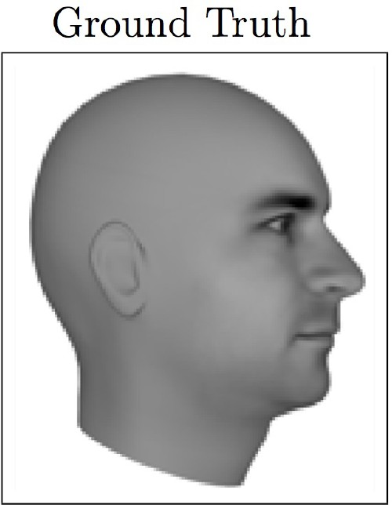
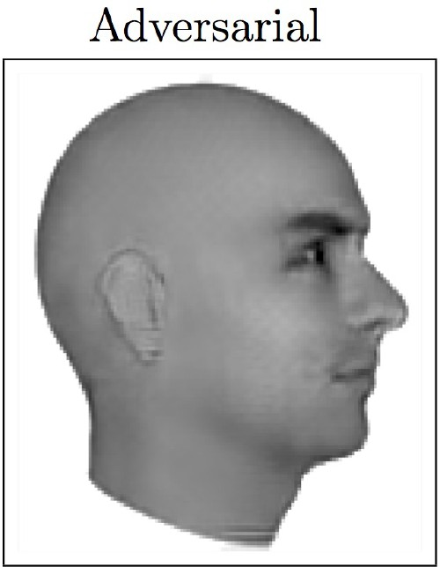
Magic of GANs…

Slide 4
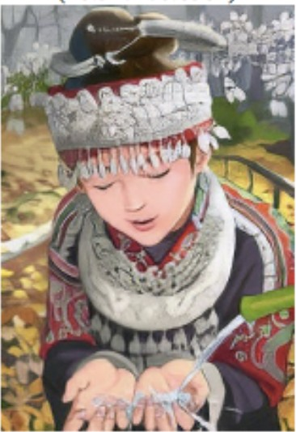

Magic of GANs…
Which one is Computer generated?

Slide 5
Adversarial Training
GANs extend that idea to generative models:
Generator: generate fake samples, tries to fool the Discriminator
Discriminator: tries to distinguish between real and fake samples
Train them against each other
Repeat this and we get better Generator and Discriminator

Slide 6
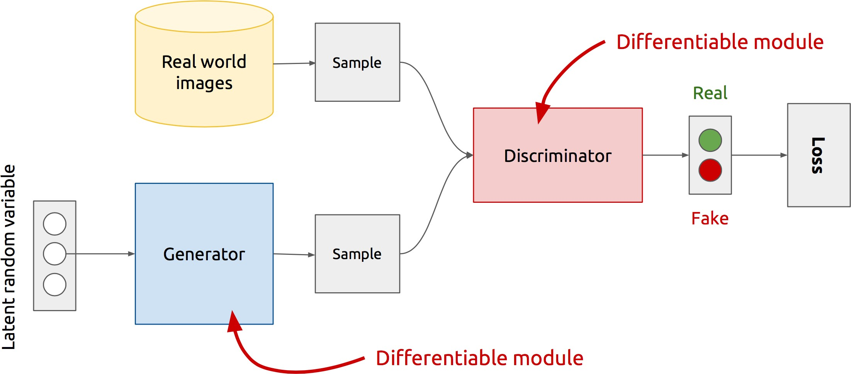
GAN’s Architecture
x
D(x) {0,1}
D
G
z
D(G(z))
G(z)
Z is some random noise (Gaussian/Uniform).
Z can be thought as the latent representation of the image.

Slide 7
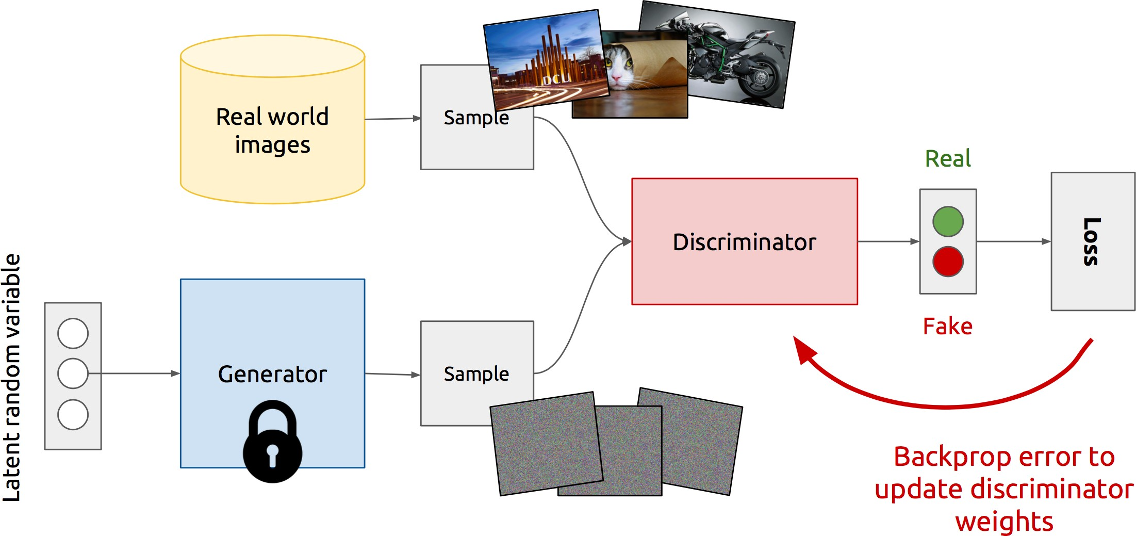
Training Discriminator:
First Discriminator is trained on some domain sample.
Then when discriminator fails to discriminate fake data over true data, that time discriminator gets updated(through backprop) so that it will be able to discriminate properly.
Discriminator Fails !!

Slide 8
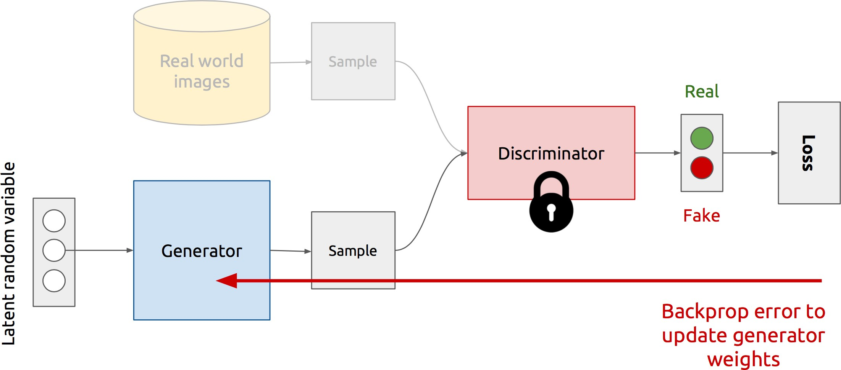
Training Generator : when Discriminator correctly discriminate fake data over true data, that time generator gets updated to produce even more complicated fake data,so that it will be difficult for the Discriminator to understand
Generator Fails !!

Slide 9
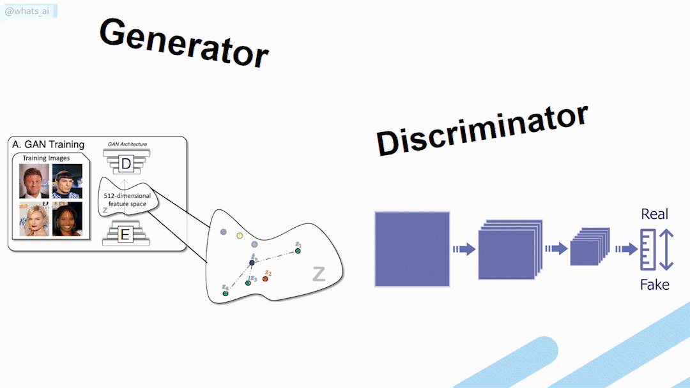
https://openai.com/blog/generative-models/

Slide 10
Loss Function
It is formulated as a minimax game, where:
The Discriminator is trying to maximize its reward max 𝑉(𝐷, 𝐺)
The Generator is trying to minimize Discriminator’s reward (or maximize its loss)
min max V(D,G) =
𝐺 𝐷
The formula derives from the cross-entropy between the real and generated distributions.

Slide 11
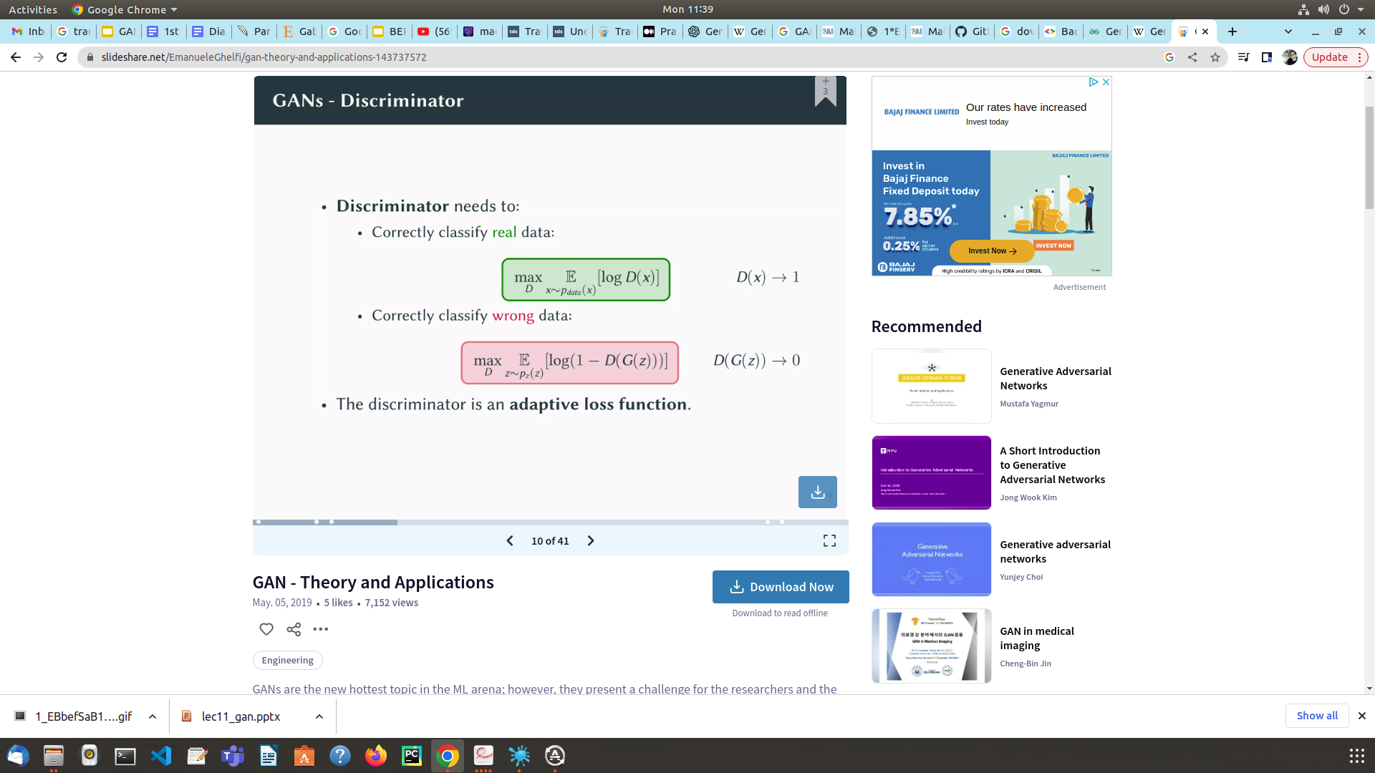
D(x) is the discriminator's estimate of the probability that real data instance x is real.
E_{x} is the expected value over all real data instances.
G(z) is the generator's output when given noise z.
D(G(z)) is the discriminator's estimate of the probability that a fake instance is real.
E_{z} is the expected value over all random inputs to the generator (in effect, the expected value over all generated fake instances G(z)).
The generator can't directly affect the log(D(x)) term in the function, so, for the generator, minimizing the loss is equivalent to minimizing log(1 - D(G(z))).

Slide 12
Different types of GANs: GANs are now a very active topic of research and there have been many different types of GAN implementation. Some of the important ones that are actively being used currently are described below:
Vanilla GAN: This is the simplest type GAN. Here, the Generator and the Discriminator are simple multi-layer perceptrons. In vanilla GAN, the algorithm is really simple, it tries to optimize the mathematical equation using stochastic gradient descent.
Conditional GAN (CGAN): CGAN can be described as a deep learning method in which some conditional parameters are put into place. In CGAN, an additional parameter ‘y’ is added to the Generator for generating the corresponding data. Labels are also put into the input to the Discriminator in order for the Discriminator to help distinguish the real data from the fake generated data.
Deep Convolutional GAN (DCGAN): DCGAN is one of the most popular also the most successful implementation of GAN. It is composed of ConvNets in place of multi-layer perceptrons. The ConvNets are implemented without max pooling, which is in fact replaced by convolutional stride. Also, the layers are not fully connected.
Laplacian Pyramid GAN (LAPGAN): The Laplacian pyramid is a linear invertible image representation consisting of a set of band-pass images, spaced an octave apart, plus a low-frequency residual. This approach uses multiple numbers of Generator and Discriminator networks and different levels of the Laplacian Pyramid. This approach is mainly used because it produces very high-quality images. The image is down-sampled at first at each layer of the pyramid and then it is again up-scaled at each layer in a backward pass where the image acquires some noise from the Conditional GAN at these layers until it reaches its original size.
Super Resolution GAN (SRGAN): SRGAN as the name suggests is a way of designing a GAN in which a deep neural network is used along with an adversarial network in order to produce higher resolution images. This type of GAN is particularly useful in optimally up-scaling native low-resolution images to enhance its details minimizing errors while doing so.

